Slide 1
Is There a God?
Evidences for Faith

Slide 2
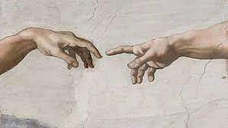
The Bible’s Premise: There is a God
In the beginning, God created the heavens and the earth
But is this a gullible premise? The Bible presents three common sense arguments. Let’s examine two of them

Slide 3
Every House Has a Builder
The House made itself?
The House came from nothing?
Someone built the House?
Romans 1:20

Slide 4
Design Demands a Designer
Psalm 19:1-6
Acts 14:15-17
Psalm 139:14

Slide 5
Lord I Believe… Our God is Alive!

