Slide 1
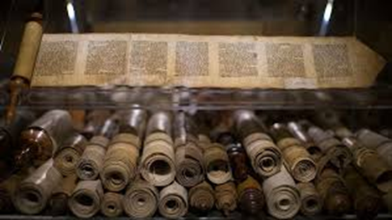
What writings are from God?
A Study of the Biblical Canon

Slide 2
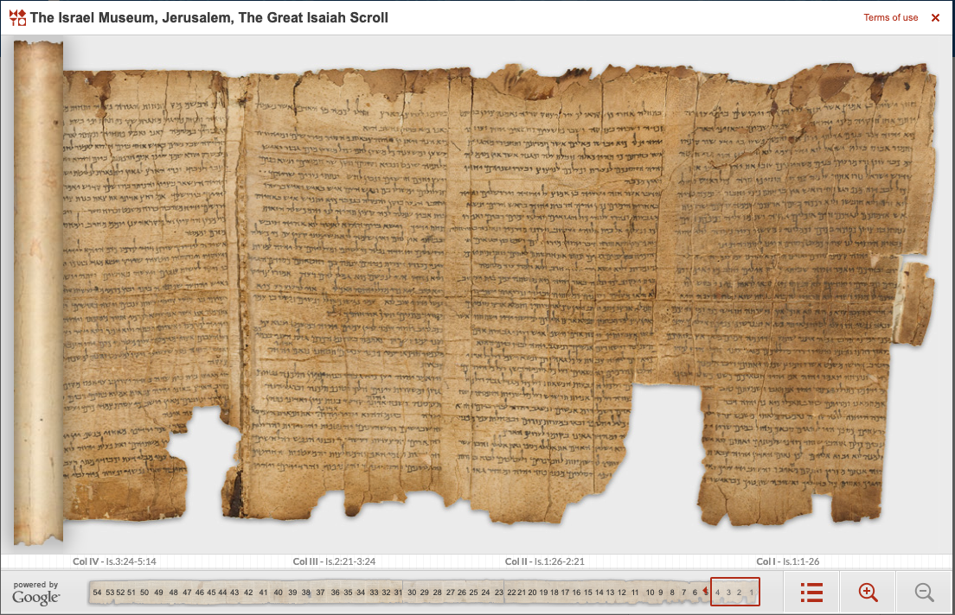
“All Scripture is God breathed”
What did Paul mean by “all”?
See context
Jews and Christians both had to answer two questions:
What scriptures are God-breathed? (Canonicity)
Have those texts been accurately copied? (Textual Criticism)

Slide 3
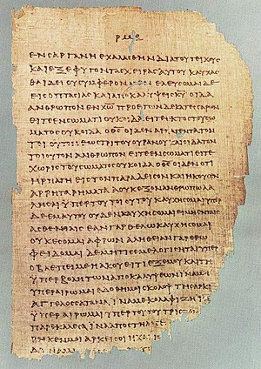
“It is rather strange that more attention has not been given in theological circles to the question of canonicity.” -- R. Laird Harris
Despite its foundation to Faith, it is surprising not more attention to this is given
There are reasons for this, but this has had the led to less faith, not more.
And it violates an apostolic instruction given in scripture that is often blindly accepted:
e.g., Peter 3:15

Slide 4
The Canon – What Scriptures are god-breathed?

Slide 5
The Canon – What Scriptures are god-breathed?
Canon comes from the Greek κανον and the Hebrew קָנֶה (qaneh). A reed used as a rule. Eventually came to mean a series or list of marks (rules)
This word was used by Paul (2 Cor. 10:13-16 and Gal. 6:16
This word came to be used for the “list” of books that make up the authoritative standard, starting with Athanasius in the 4th century

Slide 6
The Canon – What Scriptures are god-breathed?
But the concept of needing to know the “list” goes much further back than the 4th century.
Dt. 6:6-9
Gal. 1:6-9
Rev. 22:18-19

Slide 7
The Canon – What Scriptures are god-breathed?
So, two questions must be answered:
What are these writings that that we trust are from God?
How can we know this?
The problem? Who decided? How do we know they decided correctly? Do we have all? Do we have any that we shouldn’t?

Slide 8
The Canon – What Scriptures are god-breathed?
Before we go any further, let’s consider two common approaches (which I believe are misguided and have led to shallow faith and even lack of faith in God-breathed scripture). These are even found in the scholarly works.
The Holy Spirit does it for us.
The early post-apostolic church did it for us.

Slide 9
Did the Holy Spirit Determine the Canon for Us?
“One of the blessings of regeneration is that the Spirit of God opens the eyes of man’s understanding to clearly perceive these strong marks of the divine origin of Scripture to which marks he had formerly been blind. The inward testimony of the Holy Spirit enables a man to recognize the Scripture as truly from God.”
-- Edward J. Young, The Canon of the Old Testament, p. 157

Slide 10
Did the Holy Spirit Determine the Canon for Us?
This view was a fundamental position of most protestant reformers in their opposition to the Roman Catholic view that “the Church” authenticates the Canon. John Calvin, for example expounded on this in his Institutes of Christian Religion, I:86-91
Among evangelicals today, this is known as one of the “three miracles of revelation” (Inspiration, Illumination, and Discernment)
Problem: The very scriptures that the Holy Spirit allegedly enables us to know, no where argues that the role of the Spirit goes beyond inspiration (something that is clearly laid out, e.g. Ephesians 3). Makes it subjective.
NO!

Slide 11
Did the Early Church Authorize the Canon for Us?
Although it is certainly true that early Christians had to determine what scriptures were God-breathed, this view espouses that the “Church” through its Councils and Church Leaders established the “official” list of accepted books (Canon) and then passed this down to all following generations.
The inspired writing of a book was not sufficient, it had to also be “received by the Church.” Canonical status was attained by “recognition and affirmation by the Church acting officially…” Robert Meye, “Canon of the New Testament” (ISBE) Most scholars manifest this premise.

Slide 12
Did the Early Church Authorize the Canon for Us?
Problems with this view
First and foremost, it adopts an institutionalized and universally organized hierarchical conception of “the Church” that has authority to do such for everyone. This concept is not taught in the very Scriptures that are canon.
Second, there is disagreement between the Roman Catholic Church and later Protestants on the canon. The authority taken on by the 1546 Council of Trent on this matter is takes us back to the first problem.
NO!

Slide 13
Christ is the key to the canon

