Slide 1
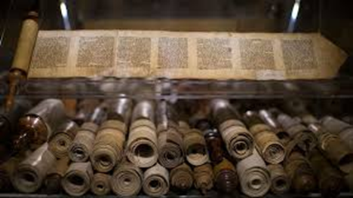
What writings are from God?
A Study of the Biblical Canon

Slide 2
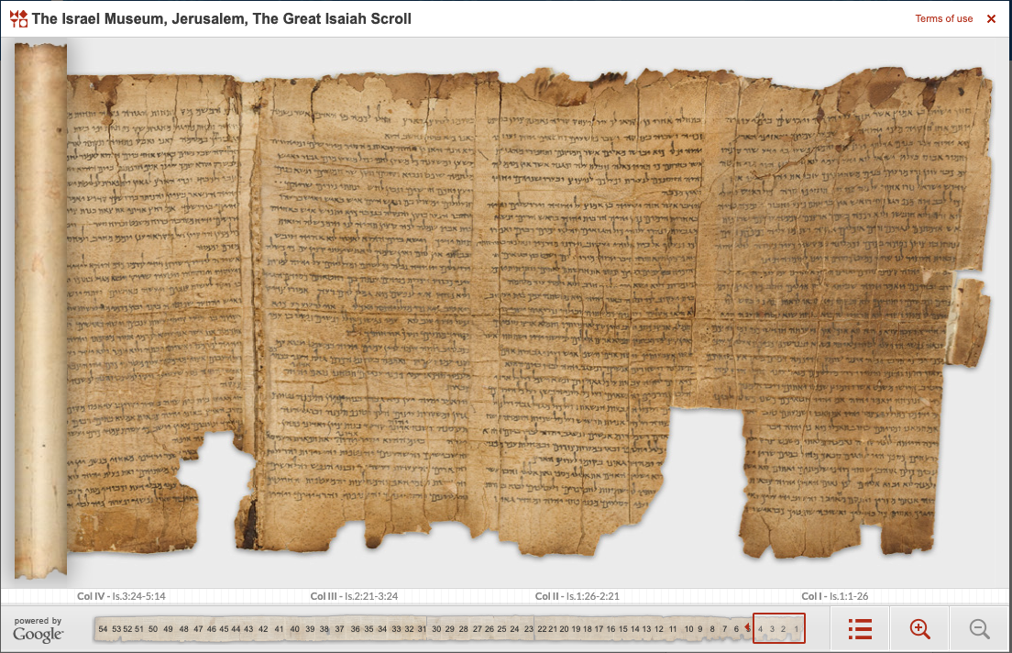
“All Scripture is God breathed”
What did Paul mean by “all”?
See context
Jews and Christians both had to answer two questions:
What scriptures are God-breathed? (Canonicity)
Have those texts been accurately copied? (Textual Criticism)

Slide 3
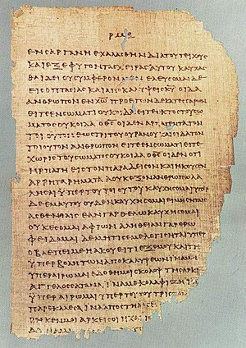
“It is rather strange that more attention has not been given in theological circles to the question of canonicity.” -- R. Laird Harris
Despite its foundation to Faith, it is surprising not more attention to this is given
There are reasons for this, but this has had the led to less faith, not more.
And it violates an apostolic instruction: 1 Peter 3:15

Slide 4
The Canon – What Scriptures are god-breathed?

Slide 5
The Canon – What Scriptures are god-breathed?
Canon comes from the Greek κανον and the Hebrew קָנֶה (qaneh). A reed used as a rule. Eventually came to mean a series or list of marks (rules)
This word was used by Paul (2 Cor. 10:13-16 and Gal. 6:16
This word came to be used for the “list” of books that make up the authoritative standard, starting with Athanasius in the 4th century

Slide 6
The Canon – What Scriptures are god-breathed?
But the concept of needing to know the “list” goes much further back than the 4th century.
Dt. 6:6-9
Gal. 1:6-9
Rev. 22:18-19

Slide 7
The Canon – What Scriptures are god-breathed?
So, two questions must be answered:
What are these writings that that we trust are from God?
How can we know this?
The problem? Who decided? How do we know they decided correctly? Do we have all? Do we have any that we shouldn’t?

Slide 8
The Canon – What Scriptures are god-breathed?
Before we go any further, let’s consider to common approaches (which I believe are misguided and have led to shallow faith and even lack of faith)
The Holy Spirit does it for us.
The early post-apostolic church did it for us.

