Slide 1
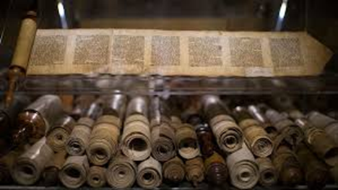
What writings are from God?
A Study of the Biblical Canon – Part Five
The Apostolic Writings

Slide 2
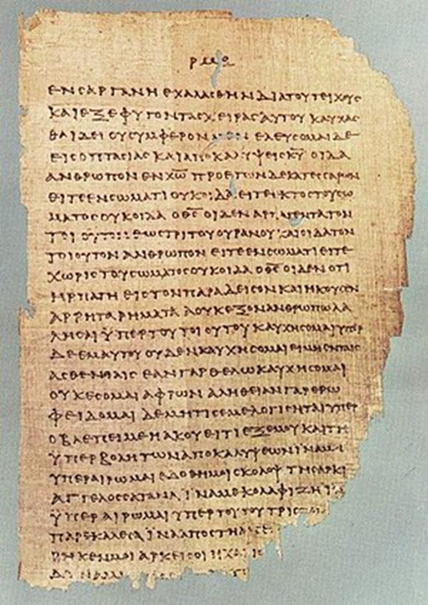
Remember:
Jews and Christians both had to answer two questions:
What scriptures are God-breathed? (Canonicity)
Have those texts been accurately copied? (Textual Criticism)

Slide 3
The Canon – What Scriptures are god-breathed?
Jesus, consistent with other historical documents, helps us understand what the Hebrew Scriptures were… but such does not exist for the what would be written after his time on earth. So…?

Slide 4
The Canon – The Apostolic Writings
But Jesus was not silent on the matter of what He expected (and commanded) would happen after he ascended back to Heaven.
He did NOT leave His own writings, but there would be a divinely inspired, Apostolic ministry, authority, and message!
This implies that His disciples would seek this out and follow them.
John14:16; 16:13-14; 20:21-23
Matthew 10:20; 16:19; 18:18
This is also acknowledged by Paul: Eph. 2:20; 1 Thess. 2:13; 2 Thess. 2:1-3

Slide 5
The Canon – The Apostolic Scriptures
So, did the Apostles fulfill their ministry?
Yes… and did so widely:
Galatians 1:2; 2 Corinthians 1:1; James; Peter
And Paul’s writings were a collective… very quickly!
2 Peter 3:15-16
Implications?
Apostolic writings were distributed and collected (Col. 4:16)
Apostolic authenticity was an early decision to be made even by the apostles themselves

Slide 6
The Canon – Was the Implied Process Reality?
Yes! History clearly demonstrates that the process implied by the NT writers (Apostles) was indeed accomplished by as early as AD 110! People who knew some of the Apostles were still alive!
Clement of Rome – AD 95
Ignatius of Antioch – AD 110
Polycarp of Smyrna – AD 100

