Slide 2
Even when He did mighty works not everyone believed
Some sought to trick Him
So, He spoke in parables…

Slide 3
Matt. 13:14-15

Slide 4
Parable of the Four Soils or Parable of Seed

Slide 5
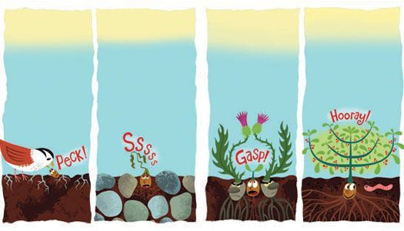
Wayside
Rocky
Weedy
Productive
Brought forth anticipated crop
Took preparation
Shallow –not deep enough
Plant died
Good start but couldn’t compete
Life chocked out
Well worn path, soil beaten down
Birds devoured

Slide 6
Wayside
Rocky
Weedy
Productive
Central Truth – How a person receives Word
Brought forth anticipated crop
Took preparation
Shallow –not deep enough
Plant died
Good start but couldn’t compete
Life chocked out
Well worn path, soil beaten down
Birds devoured

Slide 7
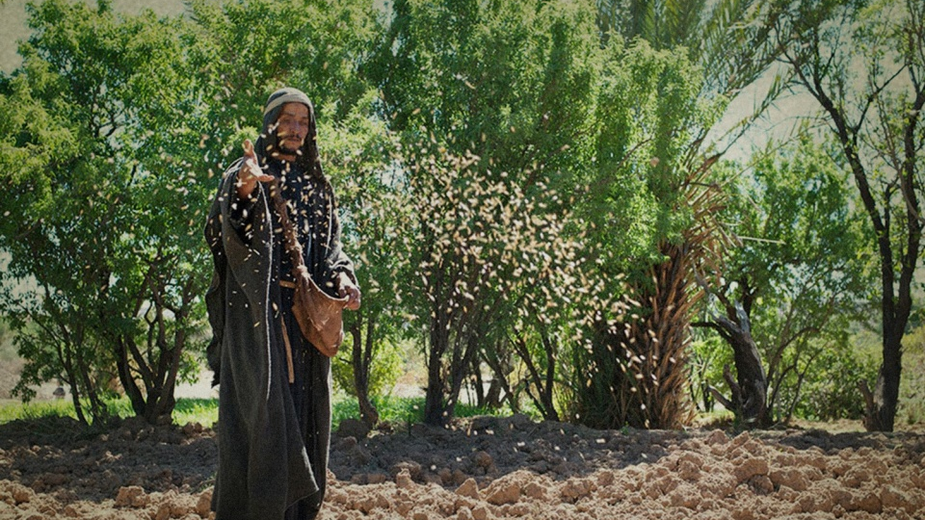
Symbolize
Sower
He who sows is Son of man
Seed
Word of God
Soil
The hearts of men

Slide 8
Closer Look at Wayside Ground
Heart hears but does not understand (13:9a)
Hearts that have been made hard
Wicked one came & devoured seed
Blinded by Satan
Satan contributed but their own choice

Slide 9
Closer Look at Rocky Ground
Hears & receives with joy
No depth or root –quickly/easily dies
Receive Word with joy but when troubles, trials, hard times come they loose their faith
Emotional reception does not guarantee the depth to survive

Slide 10
Closer Look at Thorny Ground
Receives the Word but the cares of the world choke the seed out
Cares of world, chock out the Word
Deceitfulness of riches, chock out the Word
Pleasures of this life, chock out the Word

Slide 11
Closer Look at Good Ground
Hears, understands the Word
Bears fruit
Noble hearts hear, obey and put Word to work
Like the Bereans they search Word
Must understand Word to bear fruit
Will bear different kinds & amounts of fruit

Slide 12
To benefit from The Word…
Good Ground
Hear the Word for what it is the Word of God
Hear with the aim of obeying Word
Take the Word deep into your heart
Obey whatever God commands
Bear fruit

Slide 13
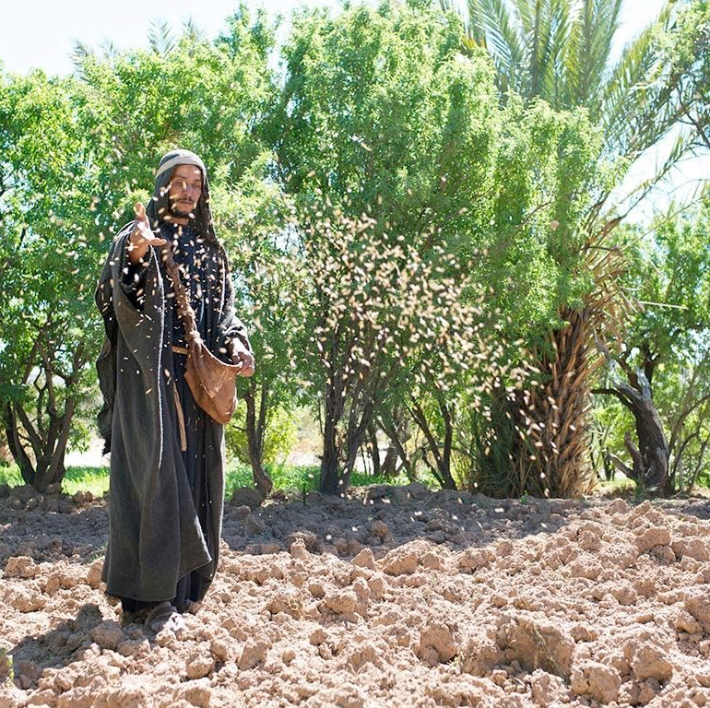
What Is Required of Those Who Sow the Seed…
Must be persistent
Must not discriminate
Prepare the ground, remove the rocks, weed, water

Slide 14
Not all who have ears really listen

Slide 15
So, faith comes from hearing, and hearing through the word of Christ (Rom. 10:17).

