Slide 2
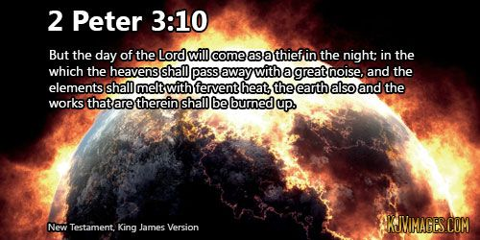
Since all these things are thus to be dissolved, what sort of people ought you to be in lives of holiness and godliness?

Slide 3
Jesus Is Coming Back

Slide 4
Answers the question, “what manner of people ought you to be?”

Slide 5
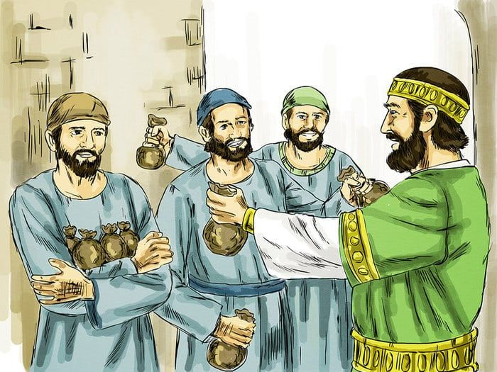
Rich Man Distributes Money to Servants
Belonged to man not independent contractors
Master intended for servants to make profit
Each according to his ability:
5 talents
2 talents
1 talent
100 years salary
40 years salary
20 years salary

Slide 6
How Was Money Used?
Lord returned after long time to take an accounting
First two doubled money
Stand with excitement
Lord praises their work –”well done”
Commends them as good & faithful servants

Slide 7
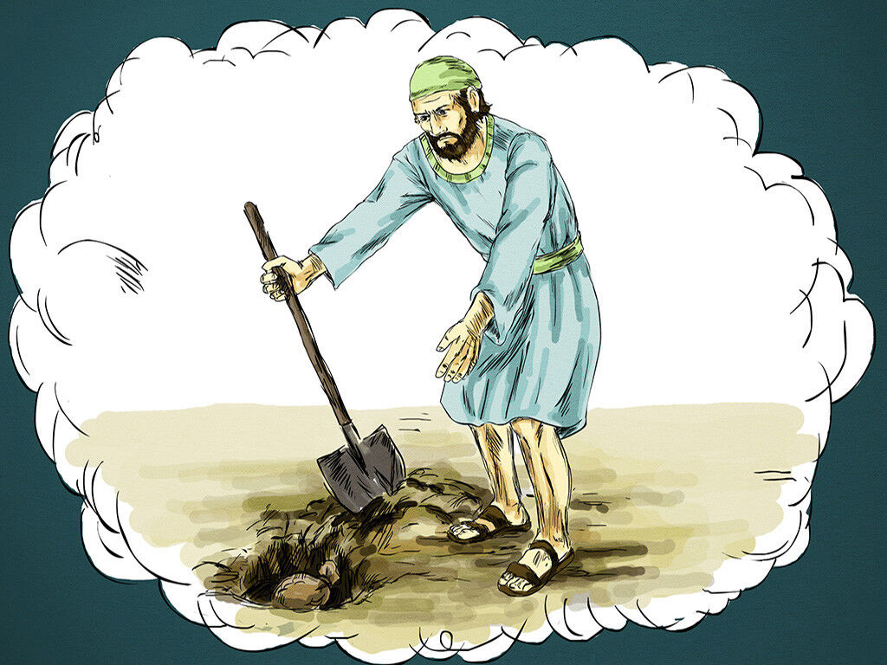
How Was Money Used?
Third servant hid money rather than making it work
Saw the Lord as a hard man
“I was afraid & hid money.”
Look I didn’t loose any

Slide 8
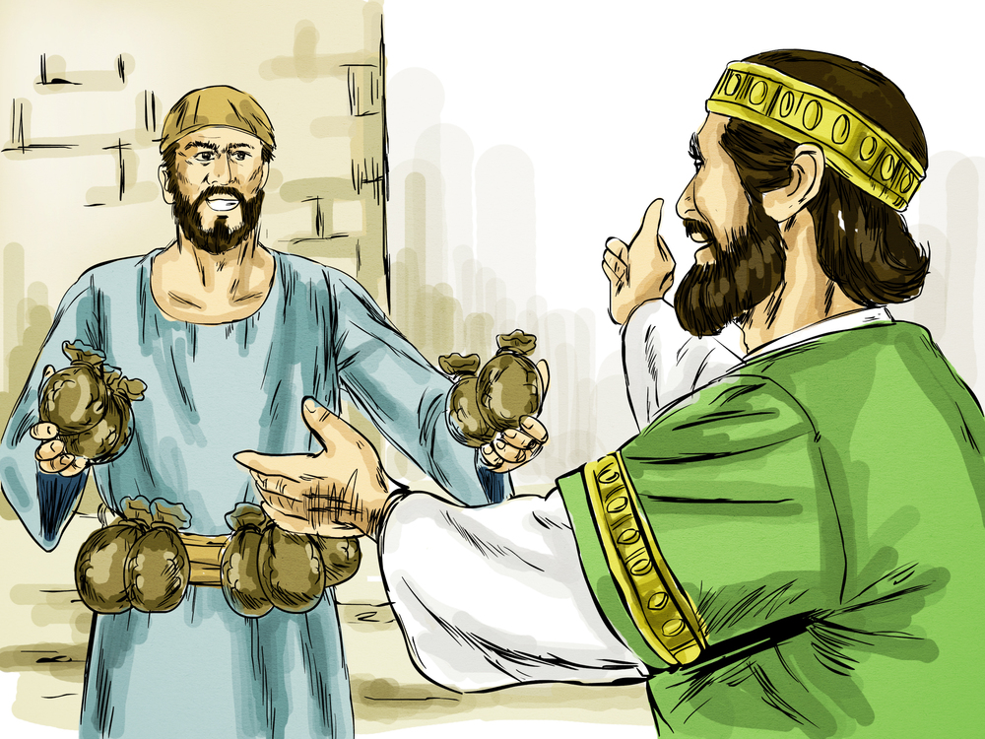
How Was Money Used?
Time For Reward
Faithful over few things I will put you over many things
Invites them to share in his happiness
Third – wicked & lazy
Takes what he has & given to other two
Unprofitable- cast into outer darkness

Slide 9
Lessons From the Parable
Each belonged to master
Rightly describes every Christian
1 Cor. 6:19-20
Lord right in expecting gain
1 Cor. 15:58
Each man given something with which to work
We have been left to make increase for Kingdom

Slide 10
Lessons From the Parable
Each belonged to master
Lord right in expecting gain
God gives enough “capitol” for job
Given according to ability
Lord left but coming back –when??
In Day of Judgment amount won’t count but effort will

Slide 11
Why Angry with Third Servant?
Sin of omission as bad as commission
Those who do evil –judged & condemned
Also, those who do nothing
Didn’t gamble away or bad investment – he just did nothing
Why 3rd servant fail?
Not because lack of opportunity
Not because given too much or little
Not because squandered

Slide 12
Why Angry with Third Servant?
Why 3rd servant fail?
Lack of faith in self
Lack of courage
Lack of faith in the Master
Saw Master just as a hard man

Slide 13
Why Angry with Third Servant?
Not condemned because he didn’t work or make full use of talents
Condemned because of opportunities missed:
John 4:35 – fields white to harvest
James 2:26 – have live faith
John 15:8 – no work, no reward
Col. 1:10 – didn’t bear fruit

Slide 14
Lessons to Learn
Be faithful in using abilities
Diligence rewarded – negligence punished
Whatever we have is really God’s
Jesus doesn’t expect immediate results
Learn & appreciate talents
Some talents await being woke
Some come through trial/error
Some require encouragement of others

Slide 15
Lessons to Learn
God has given all talents useful in Kingdom
Are you productive with talents?
All God’s servants –expected to work
Work for Lord –never disappointed

