Slide 2
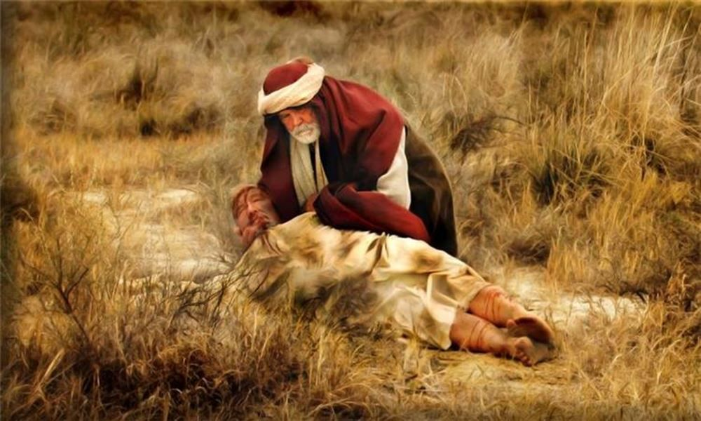
Man Robbed, Beaten and Left for Dead!!!
Rescued by Kind Man

Slide 3
²⁵ And behold, a lawyer stood up to put him to the test, saying, “Teacher, what shall I do to inherit eternal life?” Luke 10:25
Not interested in truth
Entrap Jesus

Slide 4
“What is written in the Law? How do you read it?”

Slide 5
And he answered, “You shall love the Lord your God with all your heart and with all your soul and with all your strength and with all your mind, and your neighbor as yourself.”
²⁹ But he, desiring to justify himself, said to Jesus, “And who is my neighbor?”

Slide 6
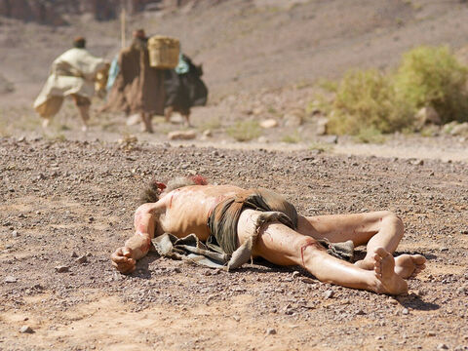
Jesus Answered With this Parable
20-mile journey
“The Way of Blood”
Beaten & robbed
Stripped & left for dead

Slide 7
A priest came by & saw the man
HE DID NOTHING!!
He didn’t hurt the man – just did nothing
Next comes a Levite
HE DID NOTHING!!
Levite stopped & looked
They didn’t see a human –saw a despised man

Slide 8
Samaritans Were Despised
“Thankful I’m not a Women, Gentile or Samaritan”
Many prayed for the Samaritans be excluded from resurrection
This Samaritan was the one to respond to the man’s needs

Slide 9
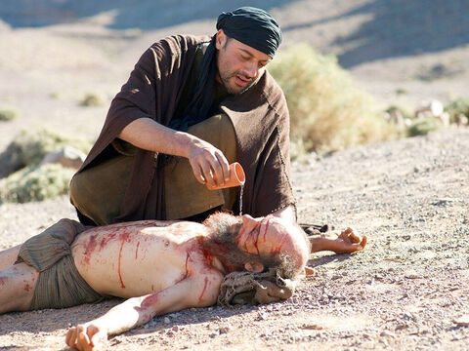
Samaritan Does for Jew What His Fellow Jews Would Not
Bandaged his wounds – with what?
Put him on his own donkey – so he walked
Pays for this strangers care
Pledges to pay more if needed on his return

Slide 10
Who Was the Beaten Man’s Neighbor?
“You go and do likewise”
“The one who showed him mercy.” Lk. 10:37

Slide 11
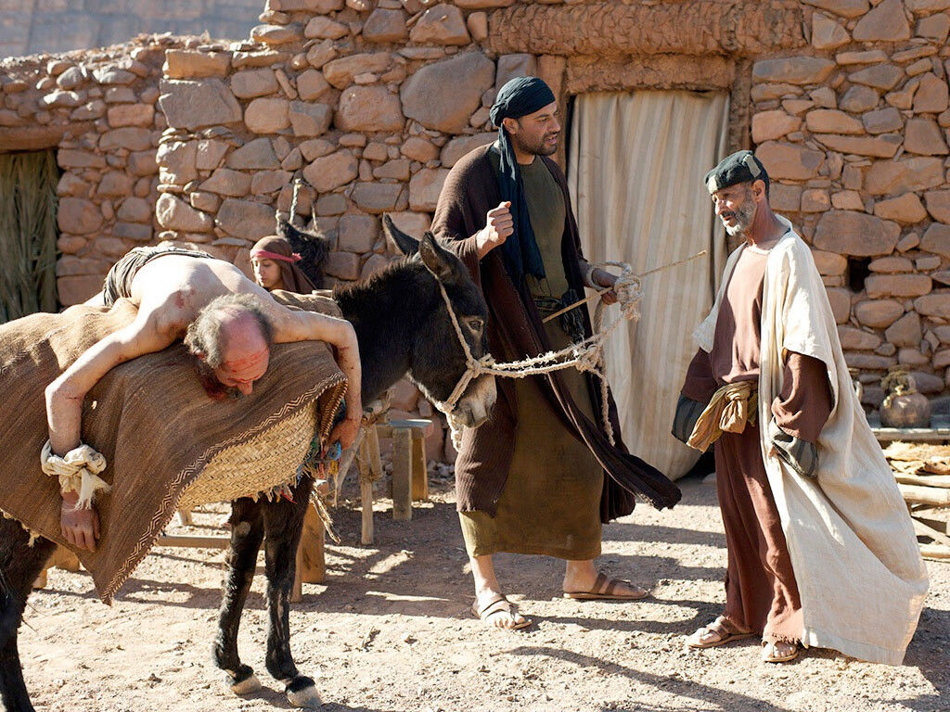
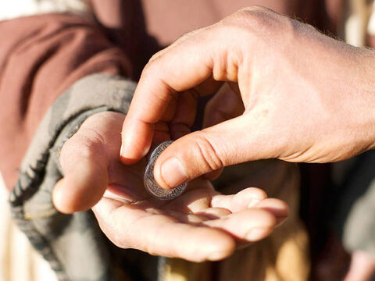
How to Apply?

Slide 12
How to Apply?
How to Apply?
Learn what it means to love our neighbor
Selfless, sacrificial commitment to another
Why did first two not stop & help?
What if robbers were nearby?
May need to get to Jericho for important religious work
May have been on way home
Would have been very unpleasant
This was a job for a doctor not a priest

Slide 13
How to Apply?
How to Apply?
Priest should have been the first to help
Had been taught in Law to love others (Lev. 19:33-34)
Separated love (neighborliness) from their religion
Showed how shallow their faith was
Knew Law but unwilling to apply it

Slide 14
How to Apply?
How to Apply?
You & I may be guilty of being the priest & Levite
Must practice pure & undefiled religion
Pure religion involves us active in the lives of others
Do something positive for those most in need

Slide 15
Lessons to Take to Heart
How to Apply?
Treat others the way we want to be treated
Jesus broke down social/racial barriers, thus we must avoid prejudice
Jesus wants us to do good for all
Doing good is pleasing sacrifice
Love in deed & not just words

Slide 16
So, who is my neighbor?
Challenged to a higher standard of love
Higher definition of who is my neighbor
Higher definition of compassion
Person in need whom we can help

Slide 17
The Lord’s lesson was this: it is not the object which is to determine love, but that love has its own measure in itself; it is like the sun, which does not ask on what it shall shine, or what it shall warm, but shines and warms by the very law of its own being, so that there is nothing hidden from its light and heat. (Trench)

