Slide 2
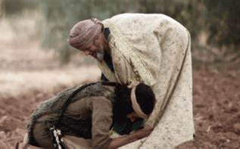
The Parable of the Lost Son
The Pearl & Crown of all parables
Gospel within the Gospel

Slide 3
The Parable of the Lost Son
Parable of Lost Son or Parable of the Loving Father?

Slide 4
The Parable of the Lost Son
Which son was the prodigal?

Slide 5
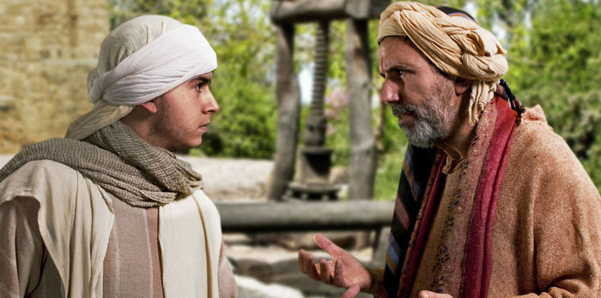
Younger son asked for inheritance
Left home to be free from restraints of father
Father gave inheritance – didn’t force him to stay
Took his money and went to a far country
The Young Son Leaves Home

Slide 6
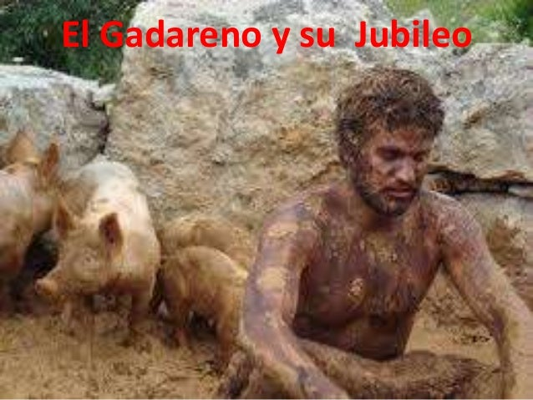
Wasted his money on loose living
Did not rain for as long time
Situation complicated by being broke & the famine
In desperation hired himself out to feed pigs
Pigs had more to eat than he did
Filthy & Starving in the Far Country

Slide 7
His journey home began when he came to his senses
He remembered his life at home (looked pretty good now)
To return home his attitude had to change
Acknowledged his sin and unworthiness to be a son
Just wanted to be a servant in his father’s house
The Younger Son Heads Home

Slide 8
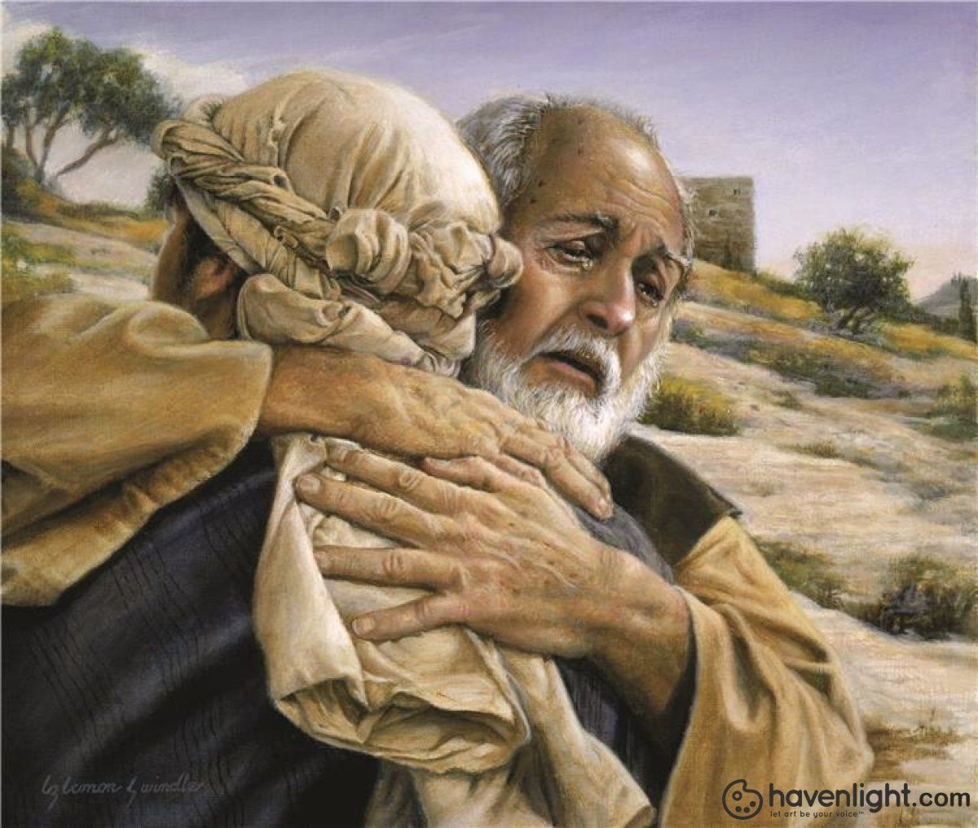
His Reception at Home
Father saw son coming home & ran to meet him
Greeted son with compassion
Ran to greet son
Threw arms around him
Father kissed son
Son quickly confesses sin
Father welcomed him back not as a servant but a son

Slide 9
His Reception at Home
Take note of what the father gave son:
Put best robe on him
Ring on his finger
Sandals on his feet
Kills a fatted calf for celebration
For this my son was dead, and is alive again; he was lost, and is found.’ And they began to celebrate.

Slide 10
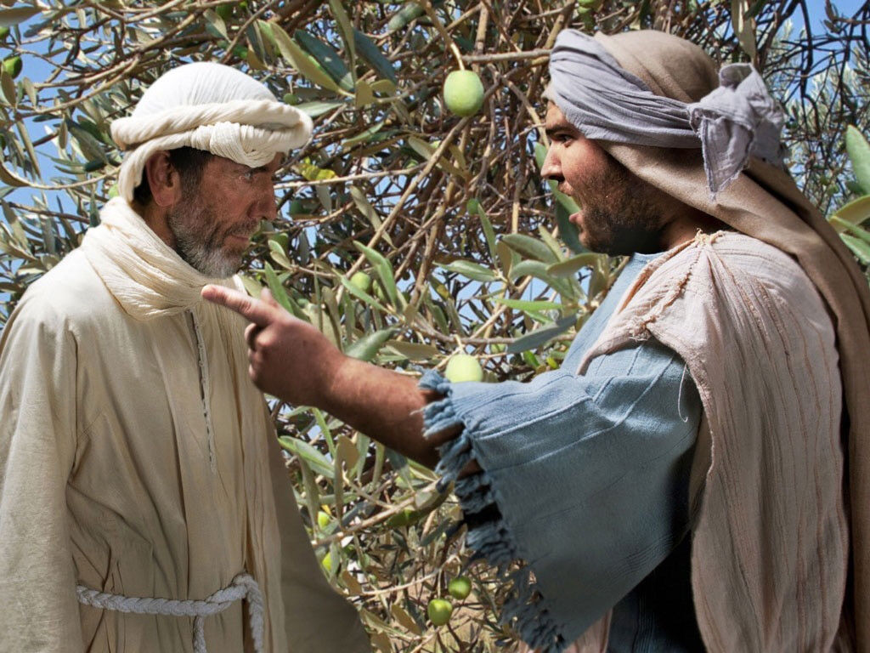
Reaction of the Older Brother
Moved by jealousy rejected brother
Hearing the noise enters angry at celebration
Older brother’s complaint
He had faithfully served his father
He had never violated father’s will
Father had never given him a party
His brother squandered inheritance

Slide 11
Reaction of the Older Father
Younger son- “son” Older brother “you”
Father assures older son he would still get his inheritance
Father asserts his right to celebrate
So, ends this Pearl & Crown of the Parables

Slide 12
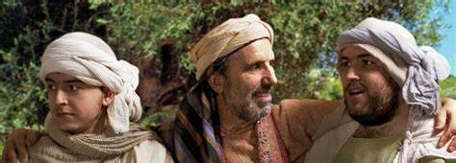
Who does each character represent?
The Father
Represents God the Father
Younger son
Represents the sinners coming to Jesus
Older brother
The self-righteous Pharisees
Far Country
Any place of sin
Home
In presence of God –place of fellowship

Slide 13
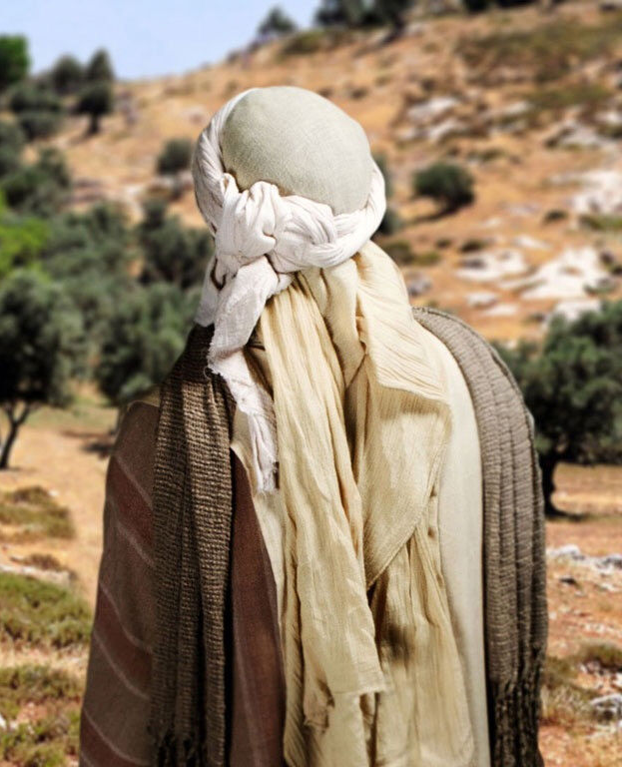
Son Did Not Find What He Wanted in Far Country
Did not find what he was looking for
Promised to be fun, exciting, fulfilling, instant gratification
Sin is only pleasurable for a short time (Heb. 11:25)
Soon discovered the far country left him empty

Slide 14
What Son Found in in Far Country
Far country “lies” believed-discovered too late
In far country truth of self not pretty
Initial experience fun, but where did it leave him?
Led him to a pig pen working for a man more concerned about pigs than the boy
Satan snares us with what looks good & only after hooked do we see the harm
Amazingly, Jesus Loves People in the Pig Pen!
Hates Pig Pen!

Slide 15
Journey Home Began When He Came to His Senses
Admitted Satan’s greener pastures were not so green
Realized where he was & didn’t like it
Some have to hit rock bottom to look up
“Empty stomach” can be a powerful motivator

Slide 16
Father’s Motivation
The father-
Fathers love their sons & want time with them
Father filled with compassion
Son’s reception-
Father ran hugged & kissed
The father’s gifts-
Best robe- cover scars of far country
Ring-symbol of trust
Shoes – indicated a free man
Party –acknowledgement of sonship

Slide 17
How Do I Set My Heart Toward Home?
Remember the blessings of home
Confront real problems- “I have sinned”
Far country only exposed inner corruption
Get in contact with our real Friend
Trust the father’s love

Slide 18
Father’s Reaction to Older Son
Older brother harshly judgmental
Disgusting superiority
Too full of himself to see the joy of reconciliation
“I’m the one who deserves a party”
Didn’t want to be treated equal –he wanted to be treated better

Slide 19
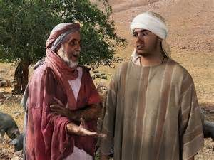
Father’s Reaction to Older Son
“How could I not celebrate- dead brother alive!”
He should join celebration –his brother alive
Older brother didn’t realize what it meant to be a son –saw father in debt to him
His faithful service acknowledged – had not earned his wealth
There but for the grace of God go I
Older had father’s name but not his heart

Slide 20
They are not pigs, the Father wants them back.
You show others the way?
G
R
A
C
E
Reach out to the prodigals of the world
Are you the prodigal?

