Slide 1
Sharers in the Body and Blood of Christ
1 Corinthians 10

Slide 2
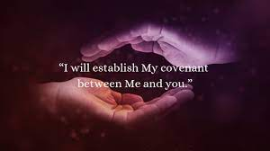
A Lesson from History
Fellowship with God is not a License
Communion is an Affirmation of our Covenant

