Slide 2
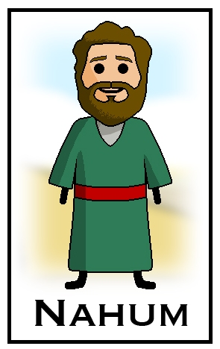
Lessons from the Book of Nahum
The Oracle of Nineveh

Slide 3
Chapter 1
Destruction is Coming from the
All-Powerful God (vv. 2-6)
God Is Good to Those Who Take Refuge in Him (v. 7)
God Will Make a Complete End of Nations that Oppose Him (vv. 8-14)
Good News for Judah (vv. 12b – 13, 15)

Slide 4
Chapter 2
Description of the Coming Destruction
(vv. 1-13)
Again, Good News for Judah (v. 2)
Chapter 3
Guilt of Nineveh and Resulting Destruction (vv. 1-19)

Slide 5
Conclusion
God Is the Sovereign Ruler, Omnipotent God Who Will Judge All Nations with Justice and Righteousness
All Will Reap What They Sow, Whether Nationally or Individually
All Will Bow before the Lord!
There Will Be Destruction of the Wicked!
There Is Safety in the Lord!
John 5:28-29 Ecc. 12:13-14

